Slide 1
Time Based Media Conservation
Overview of Media Migration and Documentation
Notes:
Hi, my name is Eddy Colloton and I’ve recently joined the team at the Hirshhorn as a Time Based Media Preservation Specialist. I’m going to be speaking very briefly about some very complex topics, so my goal today is to point you all towards some helpful resources and answer any burning questions, rather than try to squeeze too much knowledge into too little time.

Slide 2
Media Migration
Notes:
Media migration refers to the process of moving information off of unstable carriers and into a more secure format. VHS tapes, DVDs, floppy discs, are all examples of unstable carriers - they’re not ideal storage formats for preservation.
I’m going to frame my discussion of media migration around my work at the Denver Art Museum as an assistant conservator.

Slide 3
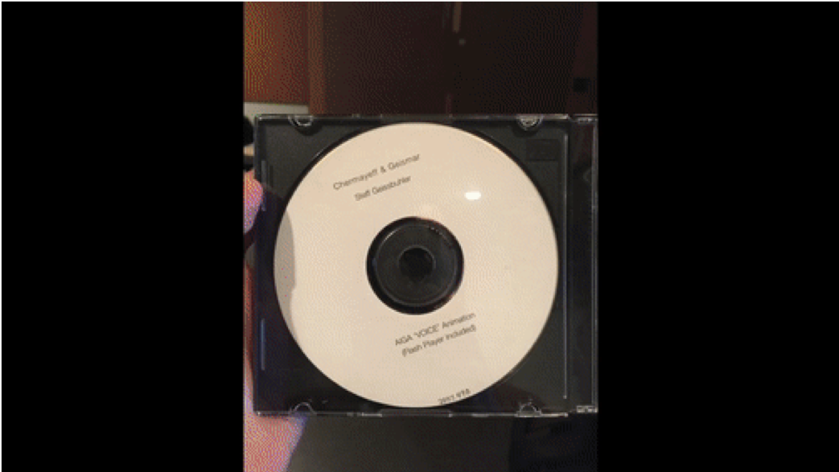
Denver Art Museum
Notes:
My position at the DAM was part of an IMLS funded project which resulted in the migration of all media works in the collection to a central server, and updated catalog records for each object associated with those works. This project resulted in the creation of over 1,117 catalog records, related to over 400 videotapes, 200 optical discs, and 40 floppy discs.

Slide 4
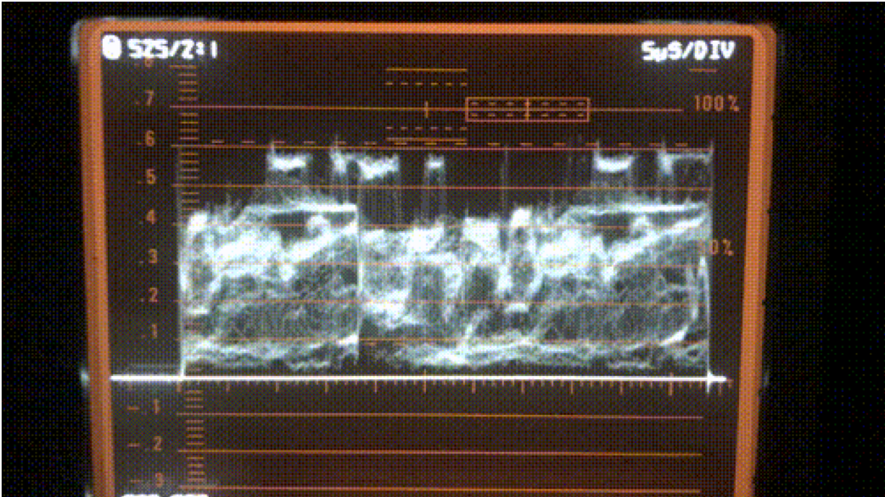
Digitization
Notes:
One form of media migration is digitization of analog media to digital formats. When I refer to analog media I referring, in a nutshell, to pre-digital media formats. Things like VHS tape, audio cassettes that kind of thing.
If there’s analog media in your collection, best practices stipulate that the media should be digitized. There’s a lot of debate around what format to migrate analog media to, which could be an hour long presentation unto itself. I’ve compiled a few resources that I hope will be helpful to you in making that decision, but depending on your familiarity with digital video formats, before I diving in, it might be best to read Chris Lacinick’s Primer on Codecs for Moving Image and Sound archive, which covers the basics of some of the variables that are weighed against each other in the other resources.
A Primer on Codecs for Moving Image and Sound Archives
https://www.avpreserve.com/wp-content/uploads/2010/04/AVPS_Codec_Primer.pdf
I’m going to refer you to Peter B.’s excellent blog post on the topic, http://download.das-werkstatt.com/pb/mthk/info/video/comparison_video_codecs_containers.html
Digital File Formats for Videotape Reformatting Part 5. Narrative and Summary Tables
http://www.digitizationguidelines.gov/guidelines/FADGI_VideoReFormatCompare_pt5_20141202.pdf
IASA TC-06
https://www.iasa-web.org/tc06/guidelines-preservation-video-recordings

Slide 5
In house
Contract with a vendor
Notes:
If you are planning on embarking on a media migration project, one of the key decisions you’ll want to make is whether or not to perform the digitization in house, or to contract with a vendor. There’s a lot of different factors that you’ll want to weigh, not simply in-house experience or know-how.
At the Denver Art Museum, we opted to contract with 2 outside vendors, Postmodern Media Services in Denver, and Maurice Shechter & Bill Seery in New York. Our decision to do this, rather than digitize our analog video ourselves, was based on 2 factors: time allotted in the grant project period, and the low likelihood of the museum continuing to collect analog audio and video materials. In the past several years the DAMs media acquisitions have been almost exclusively digital, and we felt that trend was likely to continue. In light of this trend, spending time and money investing in equipment and developing a workflow for digitization felt inefficient.
If you’re interested in building your transfer station for media migration, I would refer you to the collaborative document that Ashley Blewer originated titled “Minimum Viable Transfer Station.” In terms of sending video materials out to a vendor, I would recommend looking over “Digitizing Video for Long-Term Preservation: An RFP Guide and Template.”

Slide 6
Not all videotapes contain analog video
Notes:
Some of the tapes we saw the most errors in during our migration project at the DAM were from DV and mini DV (digital video) tapes. DV tapes can be more difficult to work with because they store packets of digital information on them, instead of a consistent stream of analog video. Due to this difference a small error can impact an entire packet of information, instead of a small aspect of a stream.
For identifying different formats in your collection, I recommend the Texas Commission on the Arts Video Identification and assessment guide http://www.arts.texas.gov/wp-content/uploads/2012/04/video.pdf
For more on the difference between migrating information off of DV tapes as opposed to analog tapes, check out: Digital Tape Preservation Strategy: Preserving Data Or Video?
https://www.weareavp.com/dv-preservation-data-or-video/

Slide 7
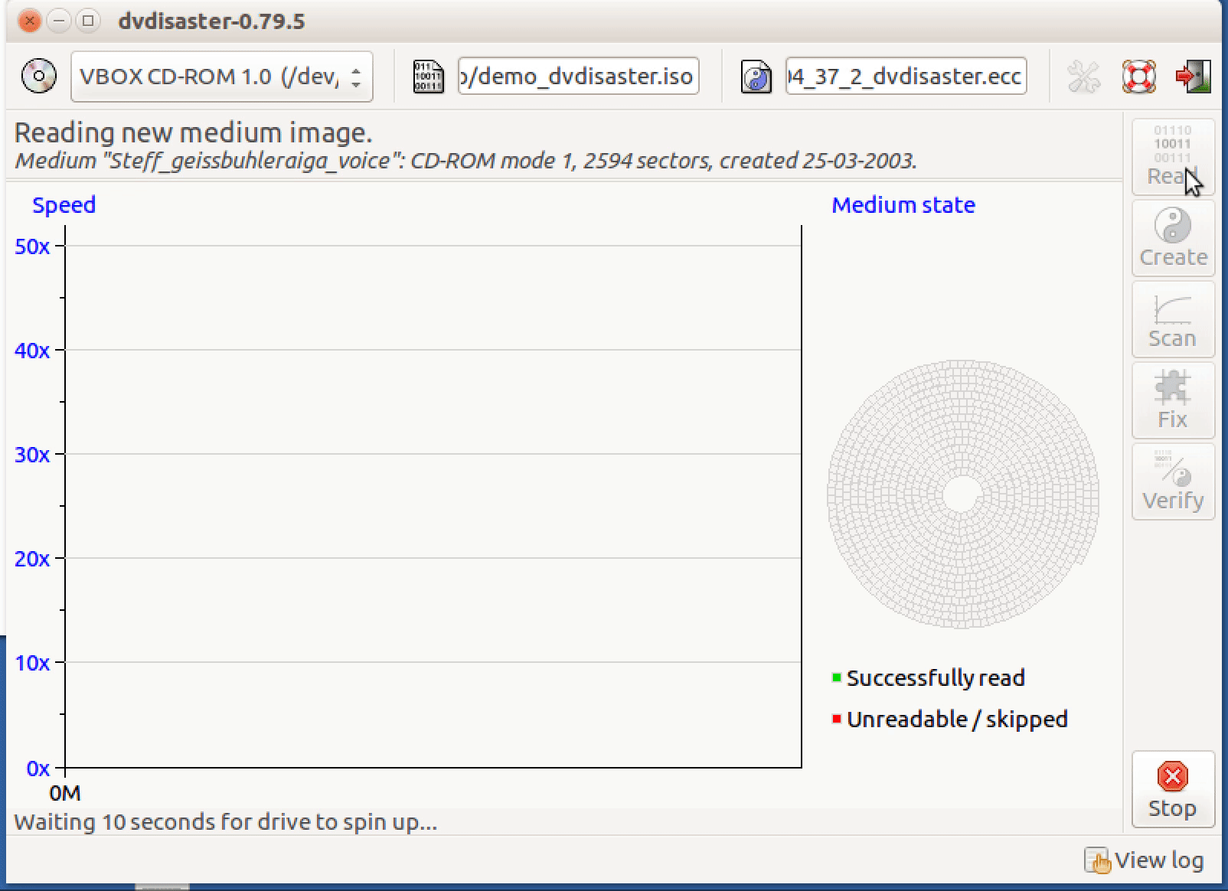
Disk Imaging
Notes:
If you have objects like DVDs and CDs or external hard drives in your collection, you’ll want to migrate the media off of those as well. Optical media (like CDs and DVDs) degrade over time, they’re easy to damage, and they’re facing obsolescence. Flash drives are also considered unstable carriers. We refer to digital storage devices like these as “removable media.” Best practices suggest the best wayt o remove data from these carriers is through a process called disk imaging.
Disk imaging allows for sector-by-sector verification of a volume, ensuring the creation of a bit-for-bit copy. Therefore, simply for the assurance of securely copying information, it is a very valuable tool. On top of that the disk image will preserve the original filesystem of a volume in a write-protected environment, and allow the user to mount the volume and explore the directory structure much as a user of the original volume would have done.
MoMA recently had a “Peer Forum” on disk imaging practices, where several of us shared our current workflows and we compiled resources. I’ve included a link to MoMA website, as well as to a webinar I hosted a few years ago that describes removable media carriers in depth and recommends disk imaging tools.
MoMA Media Conservation Initiative Disk Imaging
2018
https://www.mediaconservation.io/disk-imaging
Challenges of Removable Media in Digital Preservation
by Eddy Colloton
2017
http://wiki.americanarchive.org/index.php/Cohort_Webinars

Slide 8
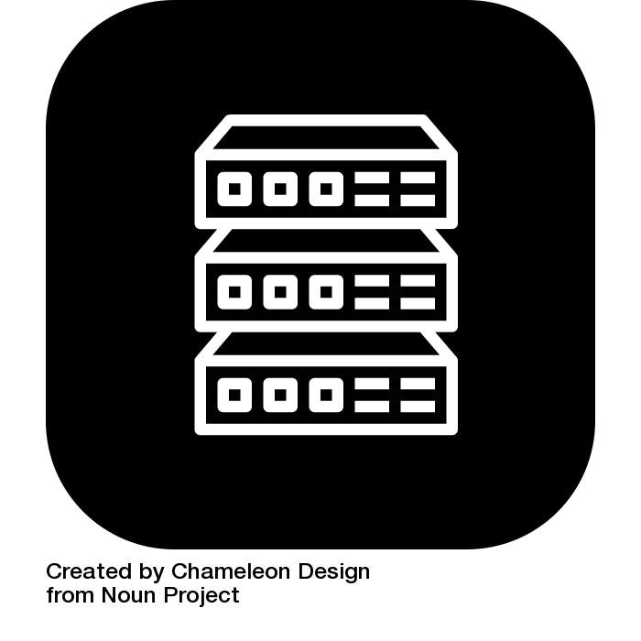
Storage
Notes:
Just because information has been migrated media off of an unstable carrier, does not mean it has been preserved. Digital preservation is complex field unto itself, with its own set of standards and best practices. Documentation and organization are key factors - you need to know what your data is, how it was made, and where to find it. These factors have been codified in a standard called the OAIS (Open Archival Information System) reference model. I’ve included a link to an article describing OAIS in the resource list. PREMIS, the resource just below that one on the list, is a metadata standard that is commonly used to help describe digital preservation - even if you don’t incorporate PREMIS into your work, it’s a helpful way of thinking about digital preservation, and the types of descriptive information that are important for media artworks.
Meeting the Challenges of Digital Preservation: The OAIS Reference Model
by Brian Lavoie
2000
https://www.oclc.org/research/publications/library/2000/lavoie-oais.html
PREMIS Resources
https://www.loc.gov/standards/premis/bibliography.html

Slide 9
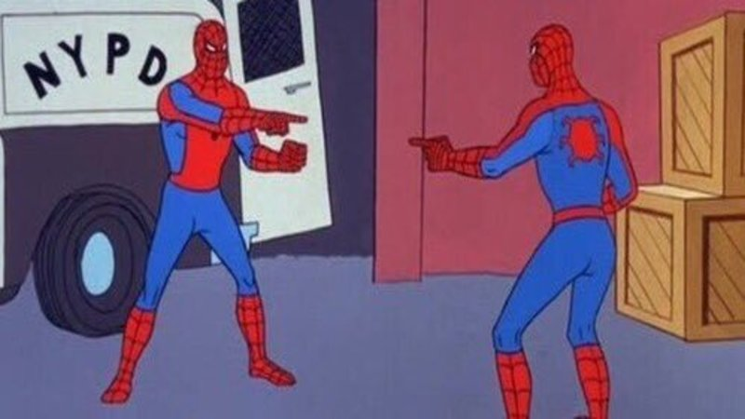
Checksums
Notes:
Checksums are a key tool in digital preservation. Checksums are the result of an algorithm that is applied to the raw data of a file, so if even one bit of one byte is different in a file, the result of the algorithm will be wildly different. So if I have a checksum from the point that a file was created, or the point the file was brought in to my repository, I have a way of knowing if that file ever changes, simply be creating a new checksum and checking it against the original.
Reconsidering the Checksum for Audiovisual Preservation
by Dave Rice
2012
http://dericed.com/papers/reconsidering-the-checksum-for-audiovisual-preservation/
Getting Started with BagIt in 2018
by Ethan Gates
2018
https://patchbay.tech/2018/03/14/getting-started-with-bagit-in-2018/

Slide 10
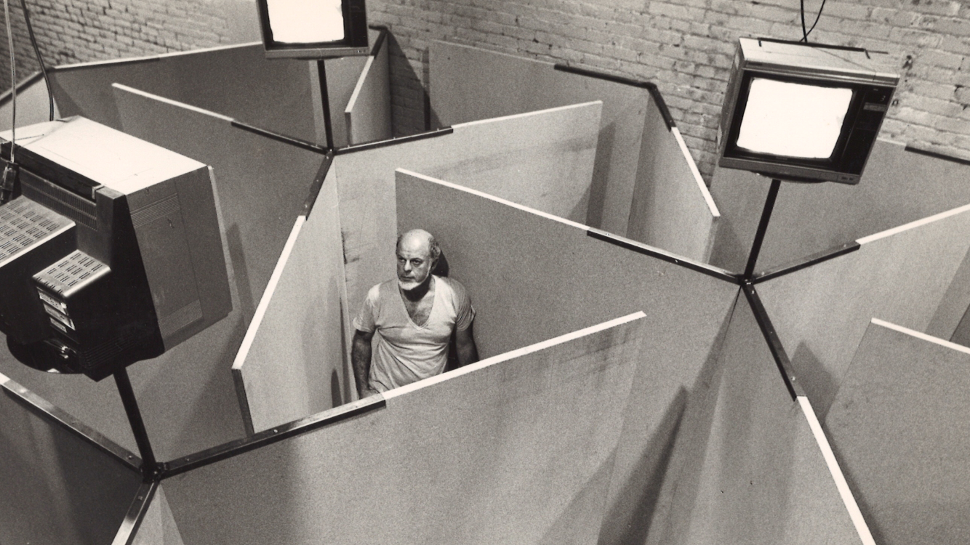
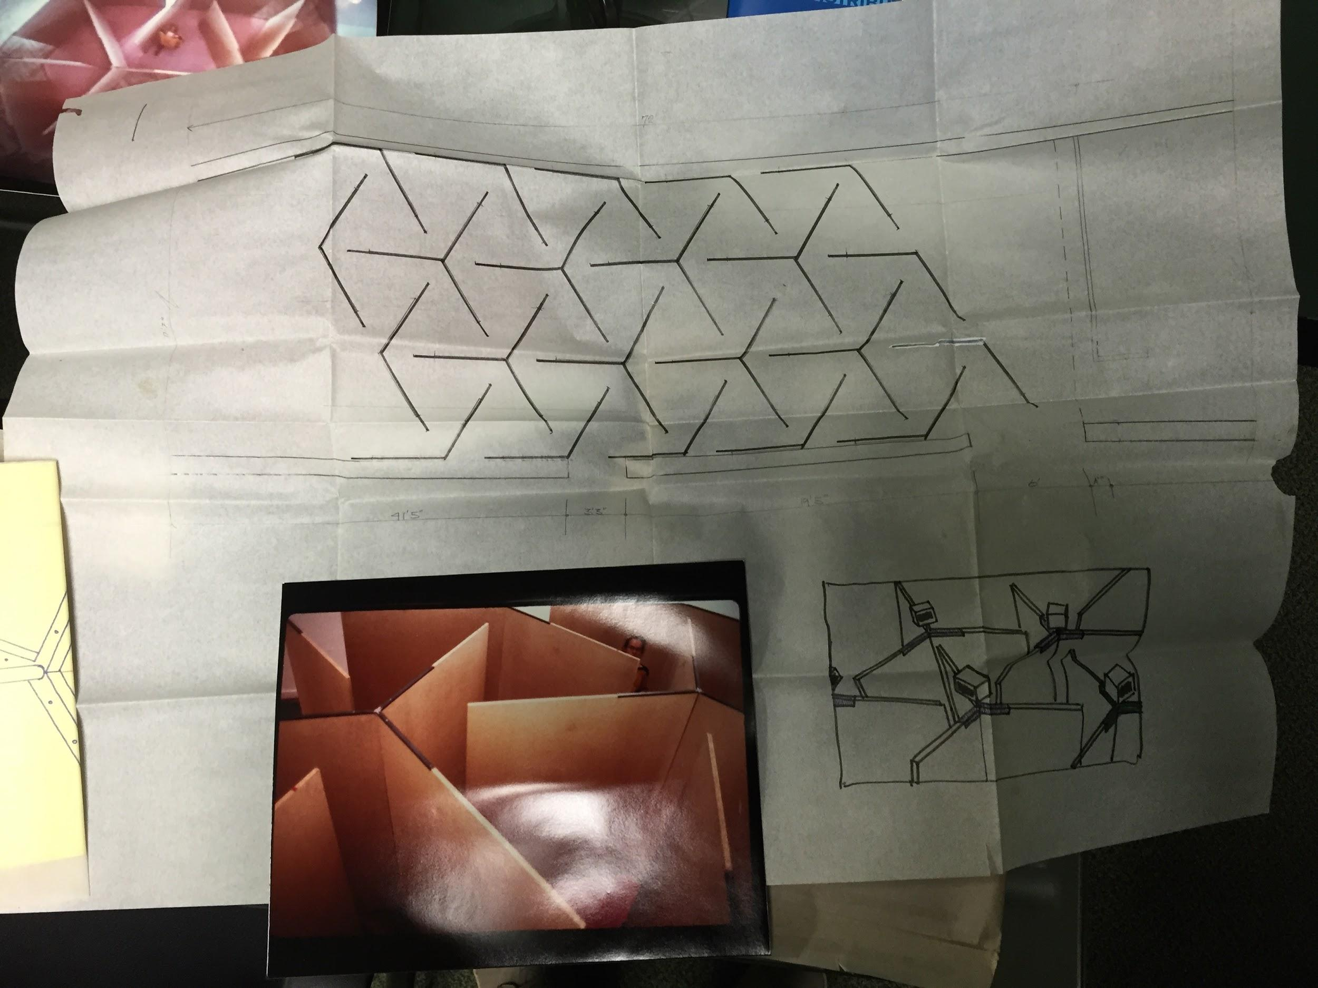
Significance of Documentation in TBM Art
Notes:
I’m going to transition here to discussing another key area of media conservation I’m focusing on today, documentation.
These are images of an installation by conceptual artist Buky Schwartz, titled
Three Angles of Coordination for Monitoring the Labyrinthian Space as it was installed at the Mattress Factory in Pittsburgh. The work was exhibited 3 other times, and was re-fabricated each time, so, in a sense this work exists purley in documentation, the specifications define the work rather than its materiality. Pip Laurenson in her article Authenticity, Change and Loss in the Conservation of Time-Based Media Installations, compares those specification to a musical score, which essentially allows a media installation to be “performed” slightly differently, depending on the extent to which the work is defined by its specifications.
Authenticity, Change and Loss in the Conservation of Time-Based Media Installations
by Pip Laurenson
https://www.tate.org.uk/research/publications/tate-papers/06/authenticity-change-and-loss-conservation-of-time-based-media-installations

Slide 11
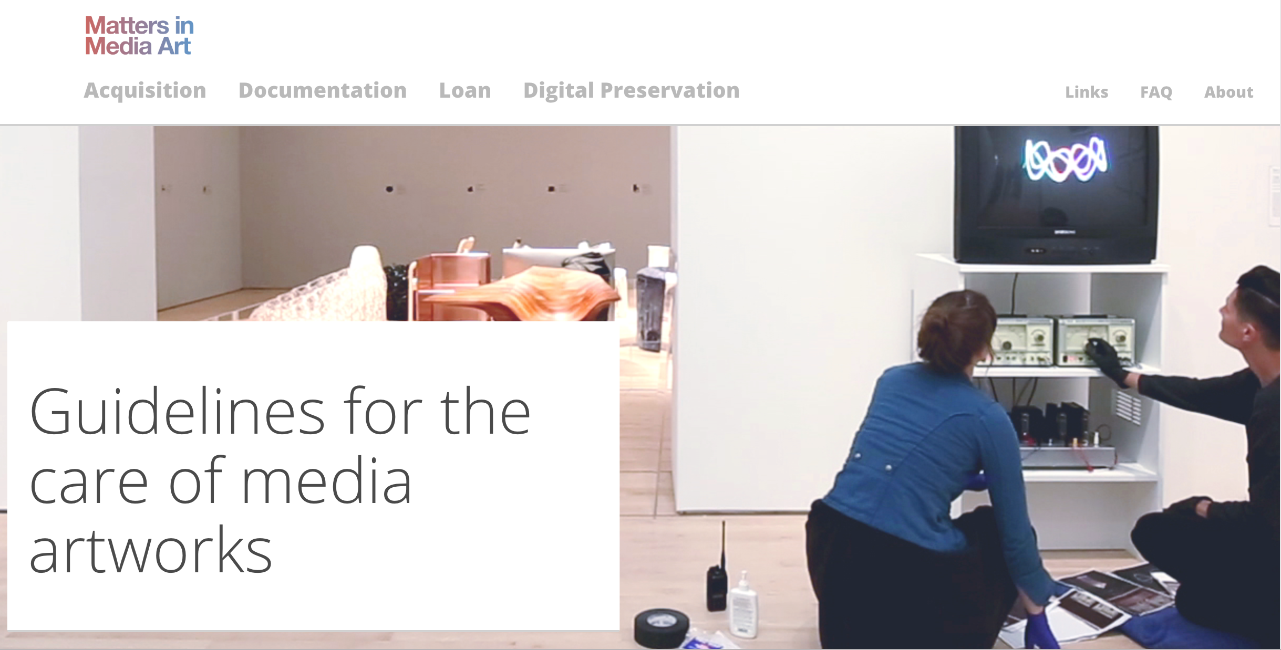
Examples of Documentation
Notes:
In that sense, documentation is a crucial aspect for preserving a work. A body of documentation that thoroughly describes several iterations of a media artwork can begin to make up the specification or the score of the work. Like other forms of conceptual art, media installations are bound to vary a bit from exhibition to exhibition, but patterns emerge over time, and those patterns can function like guiding parameters for future iterations of that work.
For examples of the types of documentation that different museums employ, I’m going to point you towards the following resources:
Matters in Media Art
http://mattersinmediaart.org/
Guggenheim Iteration Report
by Joanna Phillips
2012
https://www.guggenheim.org/conservation/time-based-media
SAAM documentation forms
by Lynn Putney and Emily Schlemmer
2016
https://www.si.edu/tbma/saam_registrar_workflow/

Slide 12
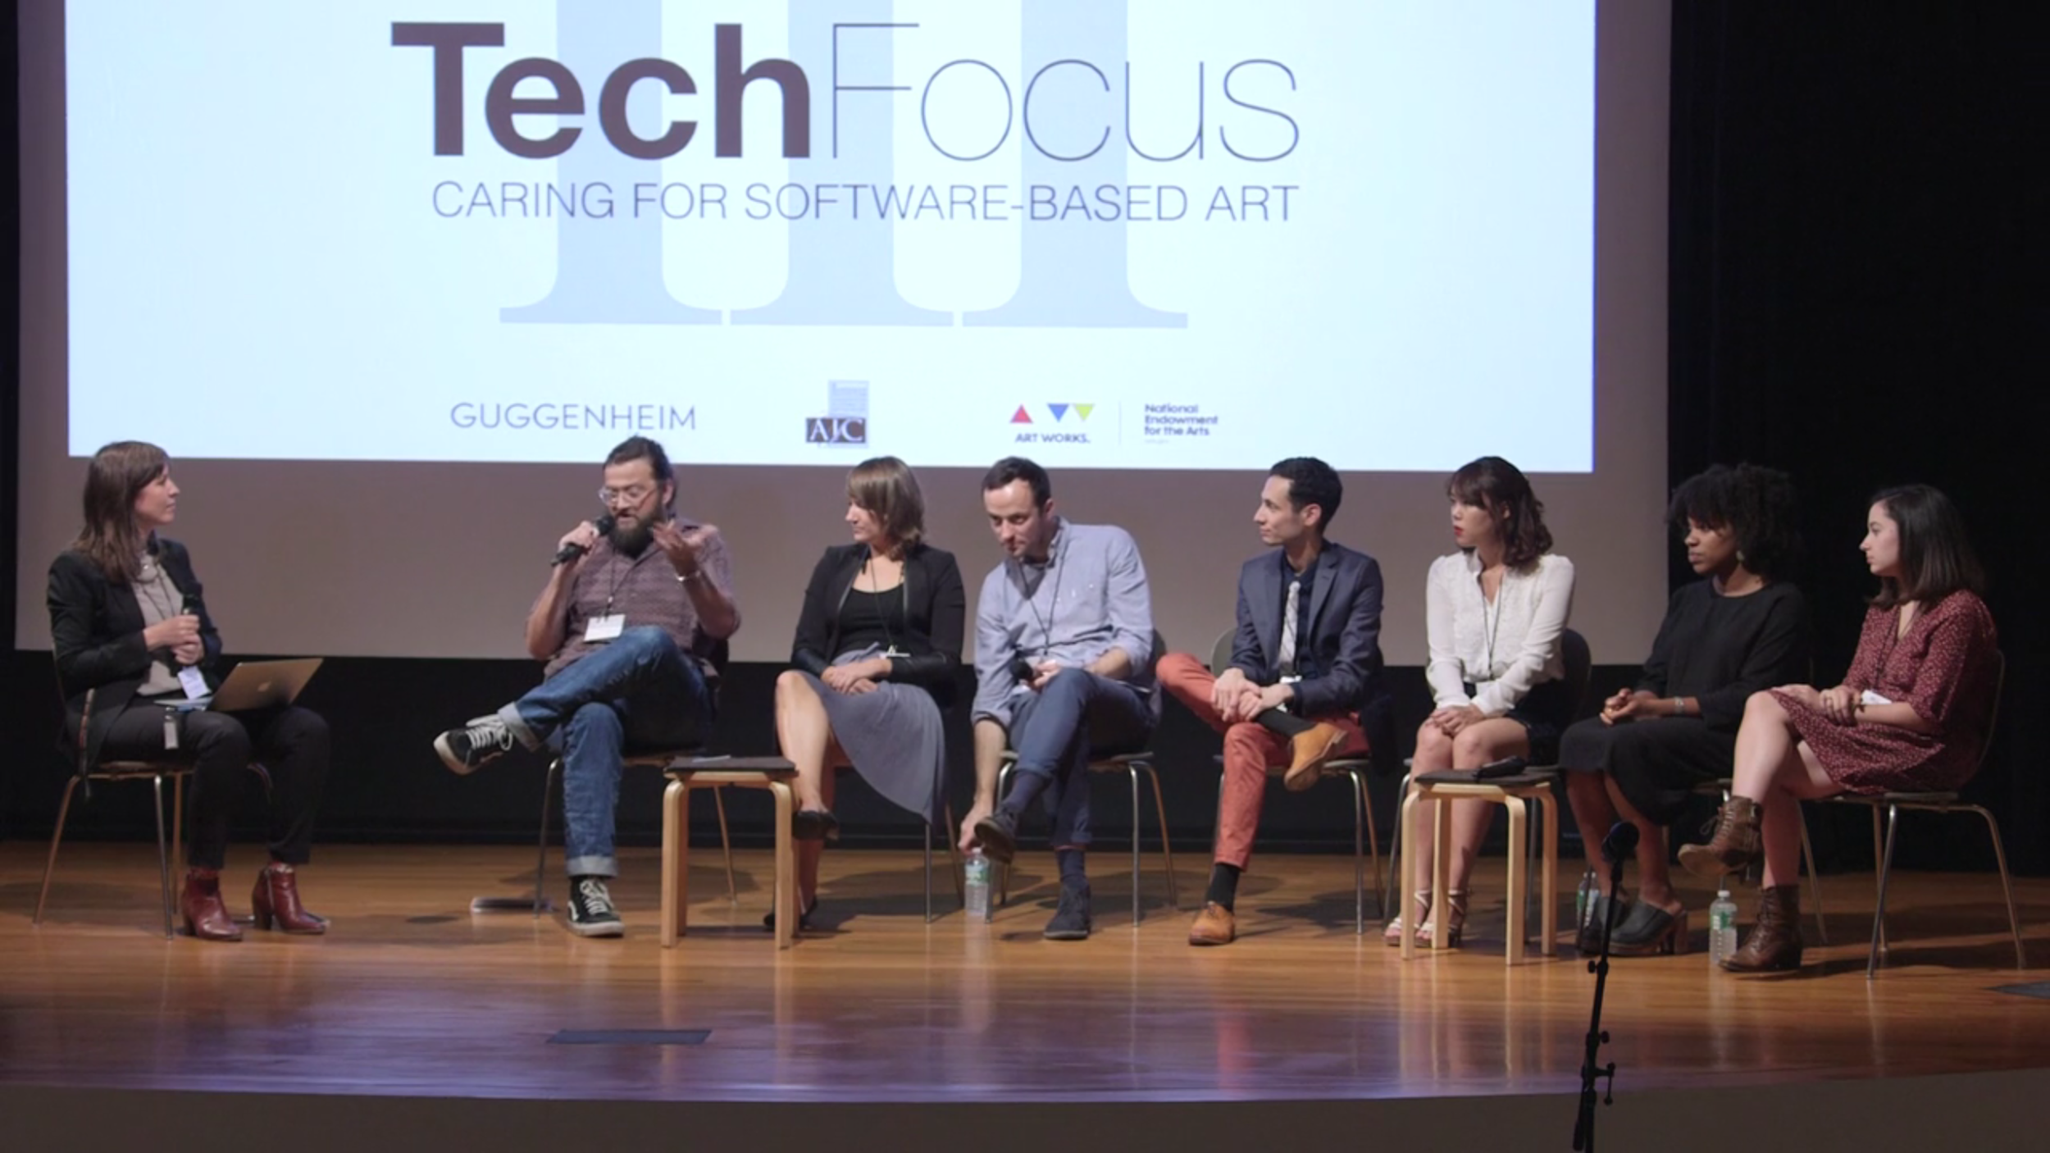
Case-by-Case
Notes:
Each artwork has its own eccentricities though. It’s one of the biggest challenges to media conservation education, or a development of best practices, because different works are, just that, different from one another. Software-based artworks in general are a good example of this, as they often have many dependencies (software or hardware they require to run correctly), and the significance of those dependencies varies from work to work.
Some good examples of case studies around software based artwork are discussed in the TechFocus III videos that are all hosted online.
TechFocus
American Institute for Conservation’s Electronic Media Group
2010-2015
http://resources.conservation-us.org/techfocus/

Slide 13
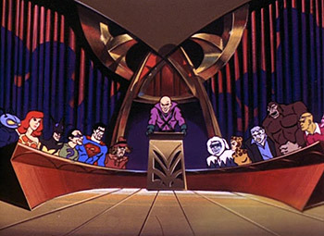
Building Consensus
Notes:
It definitely takes a village to do this type of work. You can’t be an expert in everything, and even if you could, you wouldn’t have the time or resources to accomplish everything on your own. There’s no substitute for stakeholders within your institution being apprised and involved with media conservation. I know at the Hirshhorn we work very closely with the our registrars, the exhibits department, and the assistant director of exhibits technology, who manages every aspect of AV technology. Many museum have a time based media working group, or team, which meets regularly to discuss new acquisitions, preservation projects, etc.
Two good resources on the development of media conservation practices are on the resource list. The Topics in time-based media art conservation website has this talk by Joanna Phillips presentation - Implementing Time-based Media conservation in Museum Practice, it’s all the way at the bottom of the page, but that’s the video I’m intending to point you to there, although there are some other great talks on that site as well. The final resource on that list is a capstone project from the 1st National Digital Stewardship Residency program to focus on art museums. Those final project reports nicely summarize the work that those residents did to help move burgeoning media preservation projects to the next step.
Topics in Time-based Media Art Conservation
NYU Institute of Fine Arts
https://www.nyu.edu/gsas/dept/fineart/events/time-based-media.htm
2017-2018 NDSR Art Final Reports
by Erin Barsan, Cate Peebles, Coral Salomón, and Elise Tanner
http://ndsr-pma.arlisna.org/201718-residency/blog-201718/

Slide 14
Thank you!
CollotonE@SI.edu
@EddyColloton

