Slide 1
Disk Imaging and BitCurator
@ the Hirshhorn
NYU MIAP Handling Complex Media
February 19th, 2019
Eddy Colloton

Slide 2
About Me
Time Based Media Preservation Specialist, Hirshhorn Museum
Disk imaging software-based artworks pre-ingest to DAMS
Assistant Conservator, Denver Art Museum
SO MUCH disk imaging
National Digital Stewardship Resident, Louisiana Public Broadcasting
Researched disk imaging
MIAP Student
Learned about disk imaging
Time Based Media Technician, Los Angeles County Museum of Art
Didn’t know about disk imaging

Slide 3
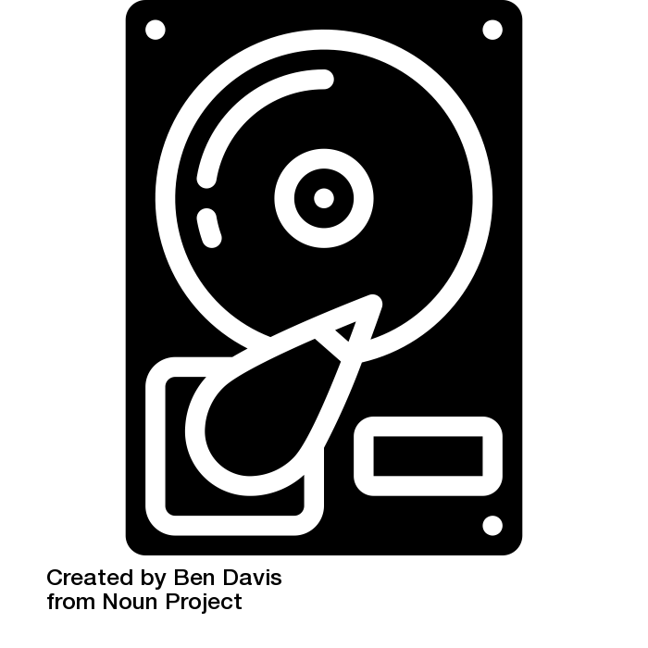
Definitions
Virtual Machine
File System
Sectors
Digital Forensics
Disk Image
Logical Disk Image
Physical Disk Image
Notes:
File system as “address book” for data, it explains where information is, how it is structured. Examples include FAT(12,16,32), HFS+, NTFS, ISO9660, etc.
Digital Forensics - “Computer forensics is the practice of identifying, extracting and considering evidence from digital media such as computer hard drives. Digital evidence is both fragile and volatile and requires the attention of a certified specialist to ensure that materials of evidentiary value can be effectively isolated and extracted in a scientific manner that will bear the scrutiny of a court of law.”
Disk Image
Telescopic difference between logical and physical disk images, physical gets more data, including deleted files, and unpartitioned space. Logical is the view a user would have of a drive if they were scrolling through “my computer.” Physical is a layer of abstraction above that.

Slide 4
Why Disk Image?
Sector verification - whether you keep the disk image or not, disk imaging is a safe way of moving media off of a volume as it creates a bit-for-bit* copy of the original volume
*assuming nothing goes wrong
Preserve original file system - prevents issues with special characters in file names, and in the case of cd-roms, can protect against accidentally creating inaccurate sector addresses
Maintain directory structure and file names - very important for websites and software

Slide 5
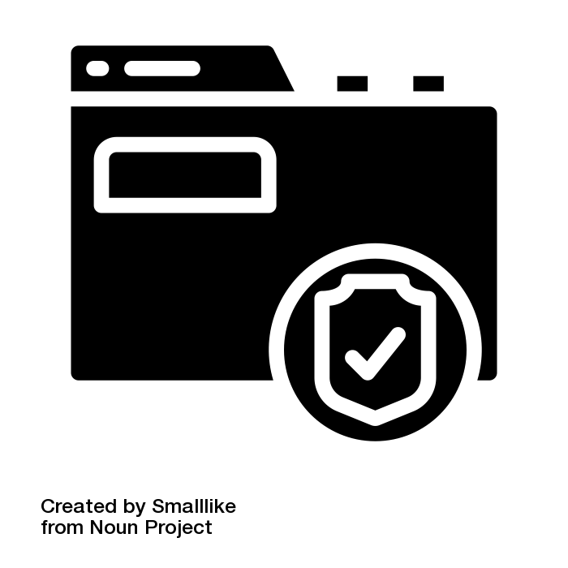
Why Disk Image?
Allow for write-protected access to identical copies of the original volume

Slide 6
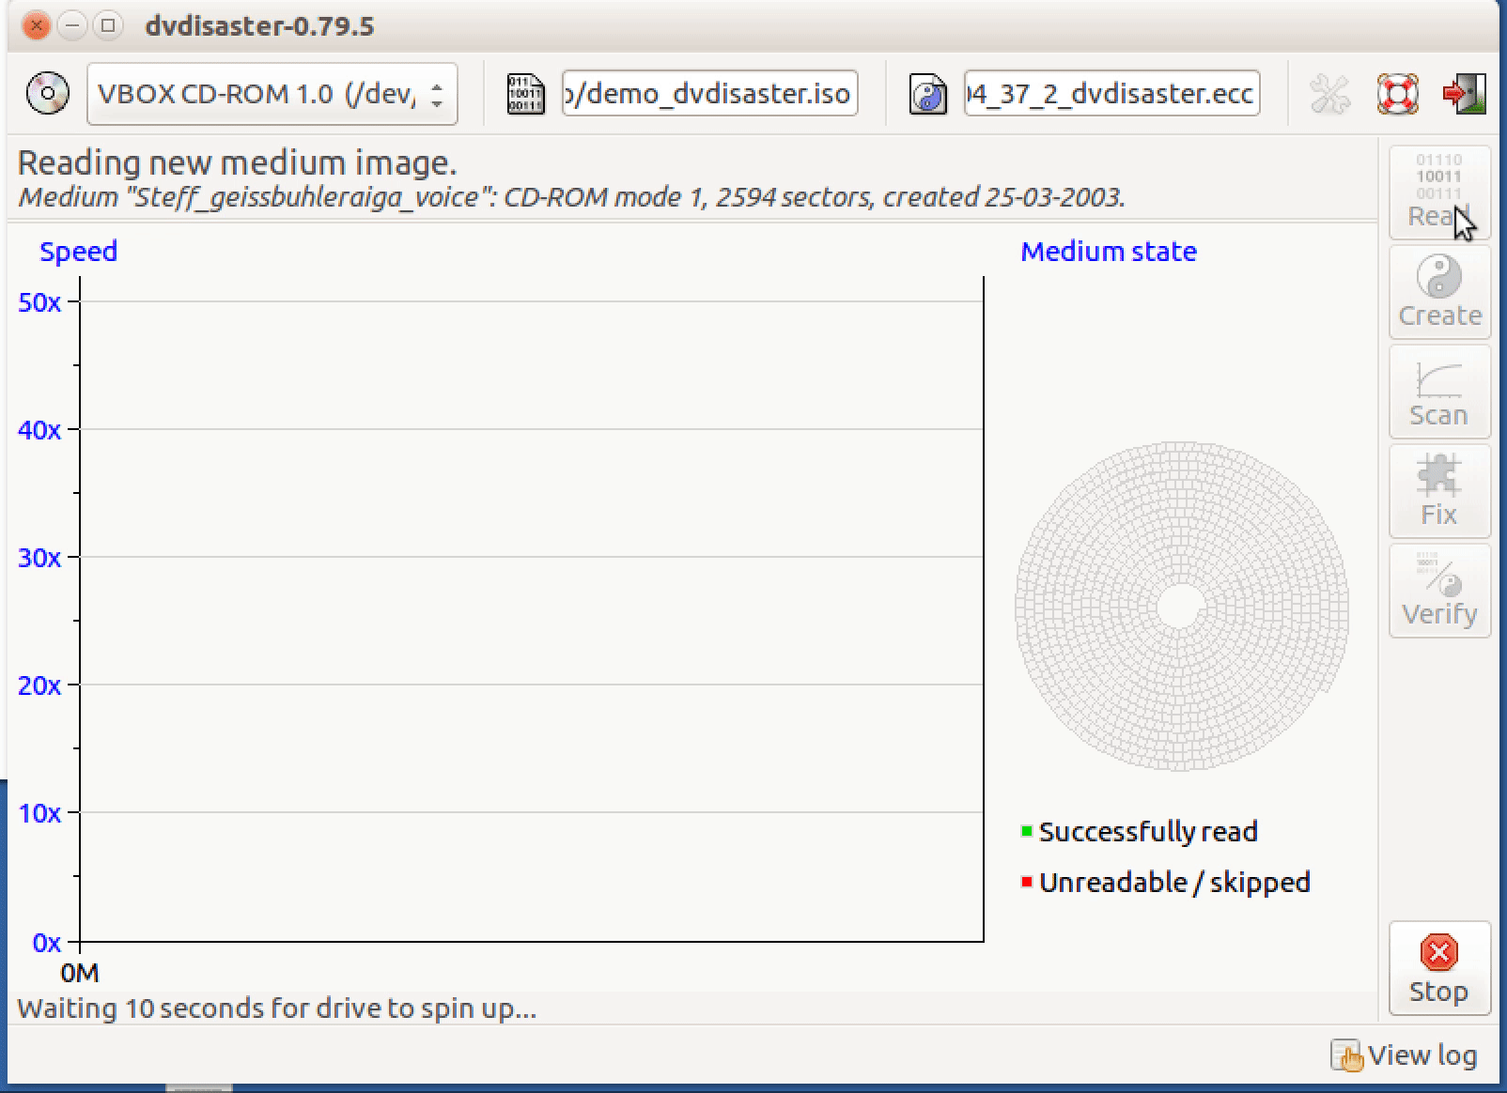
Software tools for Disk Imaging
ddrescue
Guymager
FTK Imager
Tableau Forensic Imager
EWF Lib
Kryoflux
Dvdisaster

Slide 7
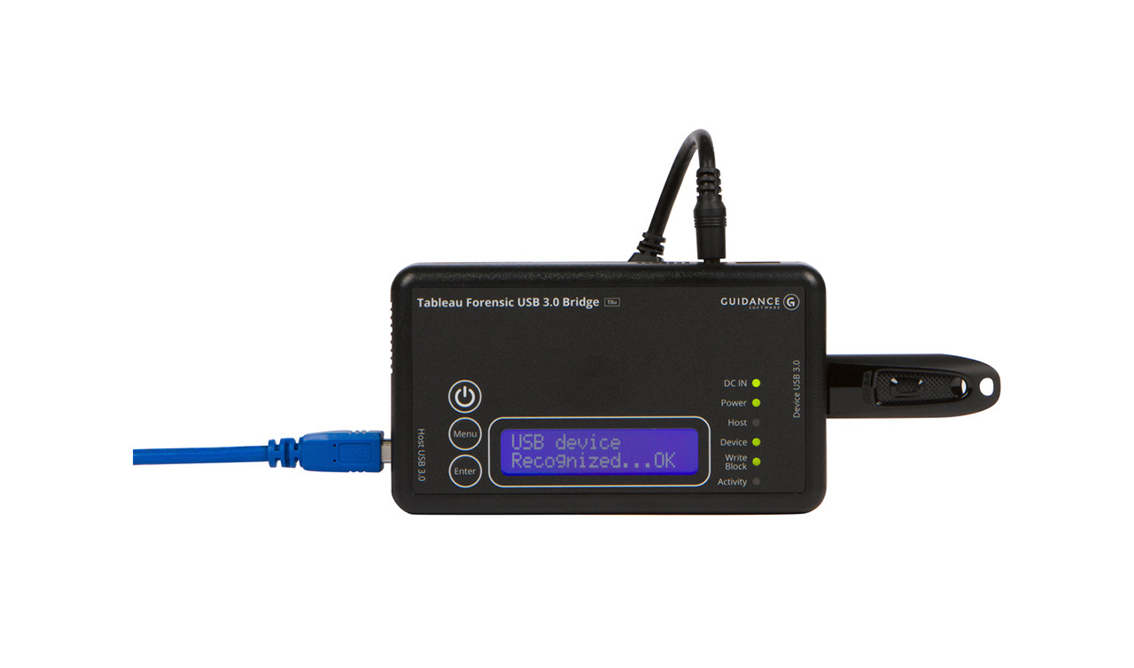
Hardware Tools for Disk Imaging
Forensic Bridge
Hard Drive Enclosures
Anti-static Wrist Strap, Mat, and Bags
“Precision” Screwdriver kit for electronics
Stand-alone Forensic Imagers
For floppy discs: Kryoflux

Slide 8
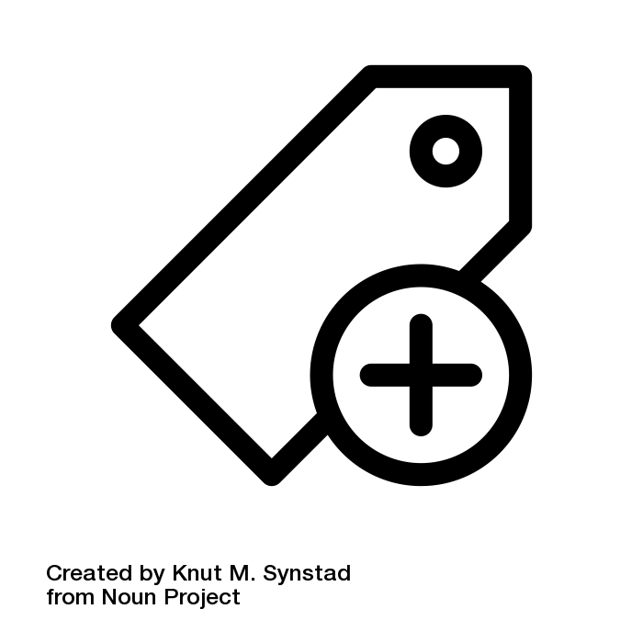
Metadata Tools for Disk Images
Imager “info file”
Disktype
SleuthKit - mmls command
FiWalk
DFXML
Dvdisaster Error Correction File?
Notes:
SleuthKit is a set of open source tools for working with disk images, designed for the digital forensics community
Fiwalk, created around 2009 is short for “file and inode walk.” The program produces which produces detailed XML describing all of the partitions and files on a hard drive or disk image, as well as any extractable metadata from the document files themselves.
DFXML is a standardized XML output to aid with compatibility across outputs from different DF tools.
Dvdisaster creates “Error Correction Files” using Reed-Solomon error correction code, the application is currently set to use RS03. Some forms of optical media will have RS error correction code already, and the application is designed to scan for and record this code if present. Currently the interoperability of these files is unknown, but they can be used to supplement a damaged disc or disk image using dvdisaster.

Slide 9
Disk Image Formats
Raw (a.k.a. dd) - Uncompressed, open
EWF (a.k.a. E01) - Lossless compression, open
DMG/IMG - Proprietary
AFF - Lossless, open, currently deprecated
File extensions muddy the water!
For example, “.IMG” can be raw.

Slide 10
BitCurator
Notes:
A suite of tools, intended to help archives and libraries perform digital forensic functions. Delivered as a VM or can be installed as “host” OS.

Slide 11
BitCurator
Suite of tools including many just mentioned:
ddrescue
Guymager
EWF Lib
Disktype
SleuthKit - mmls command
FiWalk

Slide 12
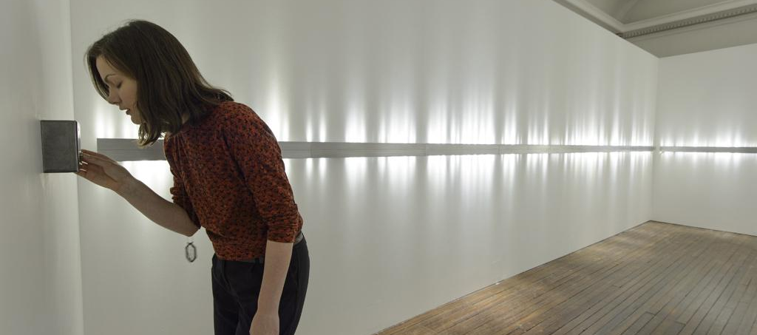
Case Study - Voice Array by Lozano-Hemmer

Slide 13
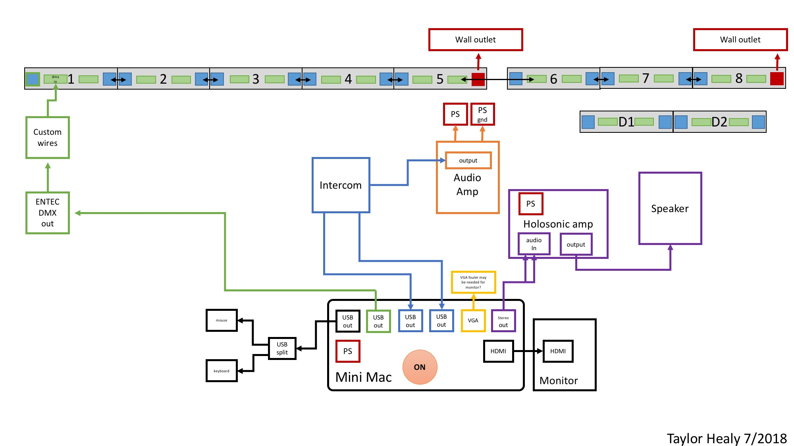
Case Study - Voice Array by Lozano-Hemmer

Slide 14
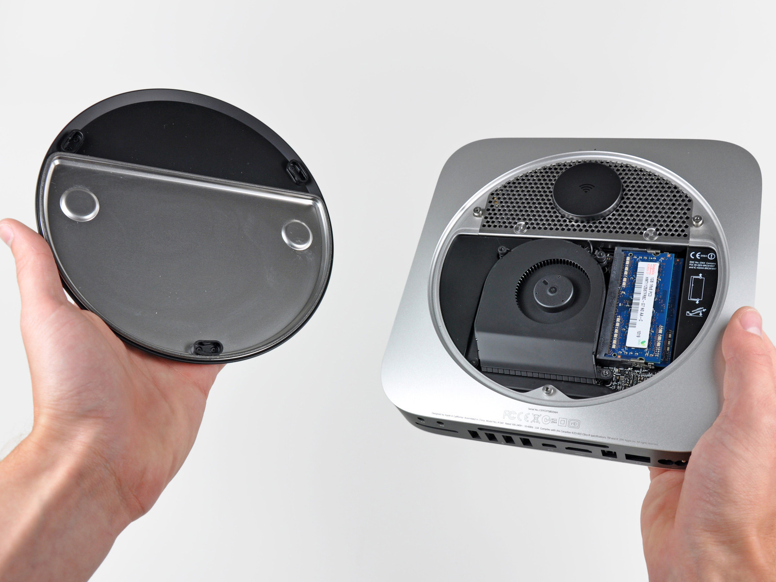
Case Study - Voice Array by Lozano-Hemmer
Mid-2011 Mac Mini
Chose to image the drive in Target Disk Mode, rather than remove the hard drive

Slide 15
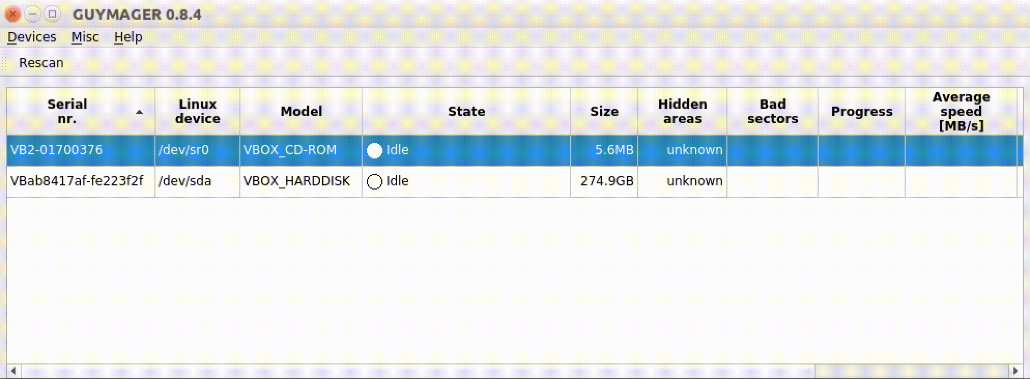
Case Study - Voice Array by Lozano-Hemmer
Issues with Guymager
Notes:
Mac Mini (mid 2011) acquired with Rafael Lozano-Hemmer’s Voice Array was booted in target disk mode, following these instructions, connected to the Hirshhorn media lab’s Mac Pro via FireWire 800 read/write blocker to USB, and, after outputting the directory structure of the machine using “tree,” we attempted to create a raw disk image using FTK Imager for Mac with the following command:
sudo /Users/Briana/Downloads/ftkimager /dev/disk1 /Volumes/TBMA\ Drobo/Time\ Based\ Media\ Artwork/RLH
Left over night, the command failed after processing for close to 15 hours.
July 24-26, 2018
Taylor Healy attempted to connect the Mac Mini to both of our Mac Pros via FireWire 800 with a thunderbolt adapter, and each time the machine froze. This mimics my experience at the DAM when attempting to connect Mac Minis in target disk mode from FireWire 800 to read/write blocker to FireWire 800 to destination computer. Contacted to Digital Intelligence to no avail. Regardless, successful raw disk image creation when connected over USB with FTK Imager for Mac, but it took 33 hours and about a 3.9 Mb/sec speed.
July 27-3, 2018
Taylor attempts to create a EWF disk image of the same Mac Mini using Guymager. The 1st attempt froze, the “time remaining simply continued to climb” (again consistent with my results at the DAM). Taylor prevented the time out by running a 20-hour looped video at the same time as disk imaging, suggesting the issue had something to do with the computer going to sleep.

Slide 16
Case Study - Voice Array by Lozano-Hemmer
Created additional disk images with the Tx1 Forensic Imager
Checksum mismatch

Slide 17
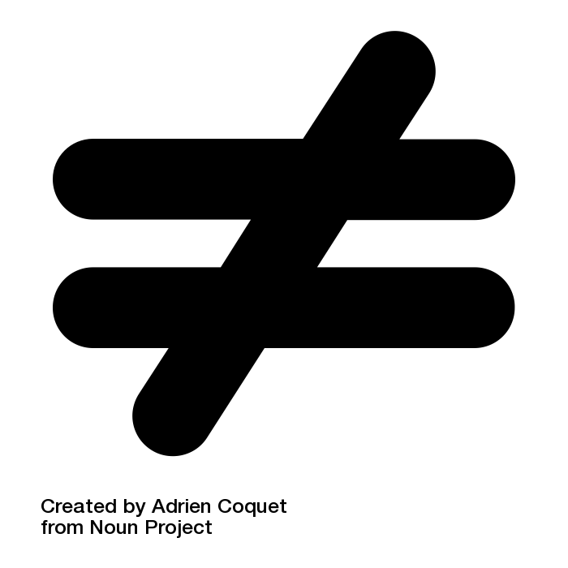
Case Study - Voice Array by Lozano-Hemmer
Differencing
Checksum manifests
File list output
“Diff-ing”
FiWalk
Python scripts
VBinDiff

Slide 18
Case Study - Voice Array by Lozano-Hemmer
More to be done!
Hedging my bets with a Time Machine backup on a thumb drive...

Slide 19
Contact Me
Eddy Colloton
eddy.colloton@gmail.com
@eddycolloton

